Slide 1

Created By:
Assistant Coordinator of
Basic Laboratorium
FASILKOM - UDINUS

Slide 2

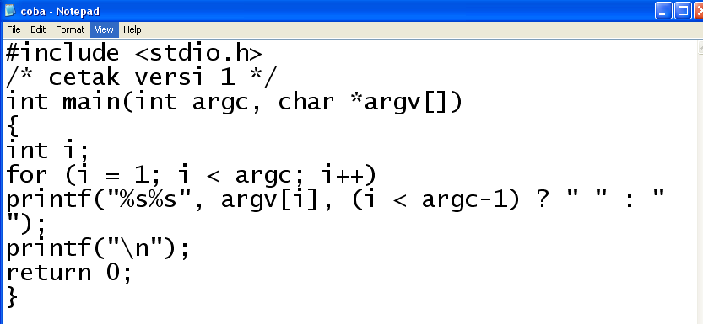
Make a “C” file
Example : coba.c

Slide 3

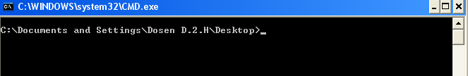
Go to command prompt
Find the directory where the ‘c’ file saved

Slide 4

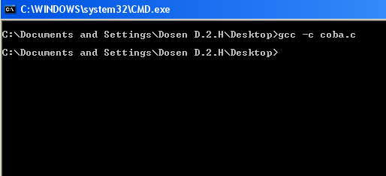
Compile coba.c file
  Format: gcc –c <namafile>
  Example: gcc –c coba.c

Slide 5

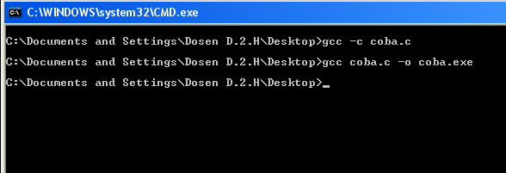
Make an executable file from c file (coba.c)
Format : gcc <namafile> -o <namafileexe>
Example : gcc coba.c –o coba.exe

Slide 6

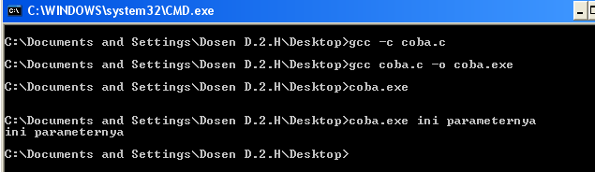
Run the executable file with using name file on command prompt
Format: <namafileexe> <parameter>
Example: coba.exe ini parameternya

Slide 7

Finish

